Slide 1

Recreational Economy
Claudette Fernandez
Rural Business-Cooperative Service
USDA Rural Development
Claudette.Fernandez@wdc.usda.gov
Phone: 202-365-5320

Slide 2

Topics
Who we are?
Why recreational economy?
Where our target communities are?
What’s available for technical assistance & financing?
How to get it done?

Slide 3
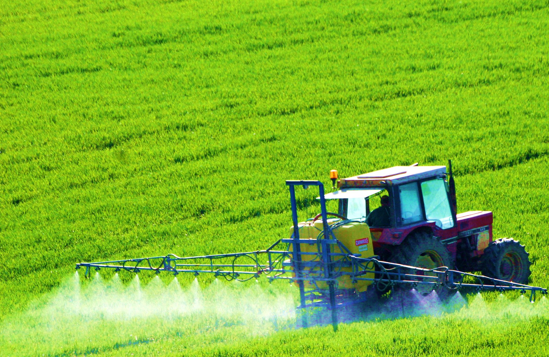
Who We Are

Slide 4
One USDA, Seven Mission Areas
Farm & Foreign Ag Services
Food and Nutrition Consumer Services
Food Safety
Marketing & Regulatory Programs
Natural Resources and Environment
Research, Education, and Economics
Rural Development
Notes:
USDA Mission Areas
Farm and Foreign Agricultural Services
Farm and Foreign Agricultural Services helps to keep America's farmers and ranchers in business as they face the uncertainties of weather and markets. They deliver commodity, credit, conservation, disaster, and emergency assistance programs that help improve the stability and strength of the agricultural economy.
Farm Service Agency (FSA)
Foreign Agricultural Service (FAS)
Risk Management Agency (RMA)
Food, Nutrition and Consumer Services
Food, Nutrition and Consumer Services works to harness the Nation's agricultural abundance to end hunger and improve health in the United States. Its agencies administer federal domestic nutrition assistance programs and the Center for Nutrition Policy and Promotion, which links scientific research to the nutrition needs of consumers through science-based dietary guidance, nutrition policy coordination, and nutrition education.
Center for Nutrition Policy and Promotion (CNPP)
Food and Nutrition Service (FNS)
Food Safety
Food Safety ensures that the Nation's commercial supply of meat, poultry, and egg products is safe, wholesome, and properly labeled, and packaged. This mission area also plays a key role in the President's Council on Food Safety and has been instrumental in coordinating a national food safety strategic plan among various partner agencies including the Department of Health and Human Services and the Environmental Protection Agency.
Food Safety and Inspection Service (FSIS)
Marketing and Regulatory Programs
Marketing and Regulatory Programs facilitates domestic and international marketing of U.S. agricultural products and ensures the health and care of animals and plants. MRP agencies are active participants in setting national and international standards.
Agricultural Marketing Service (AMS)
Animal and Plant Health Inspection Service (APHIS)
Grain Inspection, Packers, and Stockyards Administration (GIPSA)
Natural Resources and Environment
Natural Resources and Environment ensures the health of the land through sustainable management. Its agencies work to prevent damage to natural resources and the environment, restore the resource base, and promote good land management.
Forest Service (FS)
Natural Resources Conservation Service (NRCS)
Research, Education and Economics
Research, Education and Economics is dedicated to the creation of a safe, sustainable, competitive U.S. food and fiber system, as well as strong communities, families, and youth through integrated research, analysis, and education.
Research, Education, and Economics (REE)
Agricultural Research Service (ARS)
Economic Research Service (ERS)
National Agricultural Library (NAL)
National Agricultural Statistics Service (NASS)
National Institute of Food and Agriculture (NIFA)
Office of the Chief Scientist (OCS)
Rural Development
Rural Development is committed to helping improve the economy and quality of life in all of rural America by providing financial programs to support essential public facilities and services as water and sewer systems, housing, health clinics, emergency service facilities and electric and telephone service. Rural Development promotes economic development by providing loans to businesses through banks and community-managed lending pools, while also assisting communities to participate in community empowerment programs.
Rural Development

Slide 5
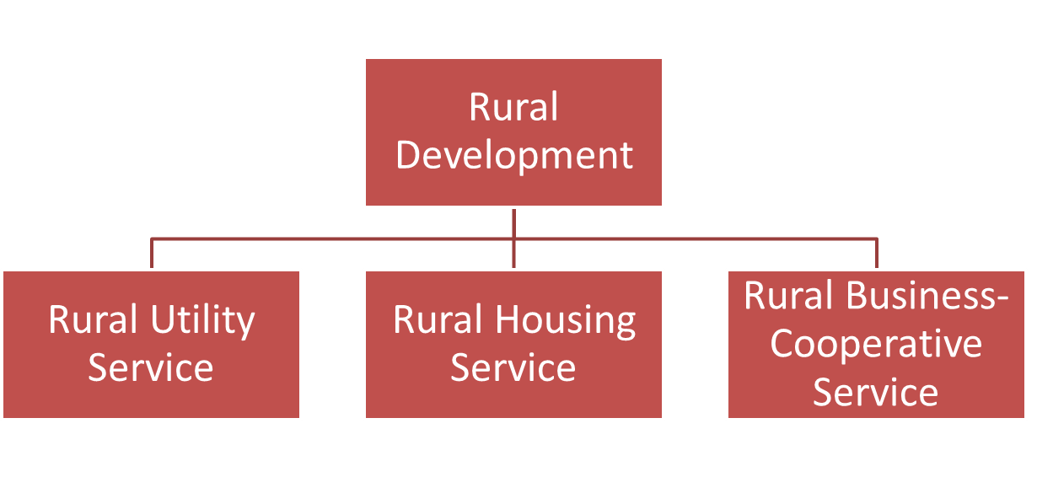
Rural Development
MISSION: It is Rural Development’s mission to increase economic opportunities and
improve the quality of life for rural Americans.
Notes:
Rural Utilities Service
Helps rural utilities expand and keep their infrastructure and technology up to date, and establish new and vital services such as distance learning and telemedicine.
Rural Business and Cooperative Service
Provides leadership in building competitive businesses including sustainable cooperatives that can prosper in the global marketplace.
Rural Housing Service
Helps rural communities and individuals by providing loans and grants for housing and community facilities.

Slide 6
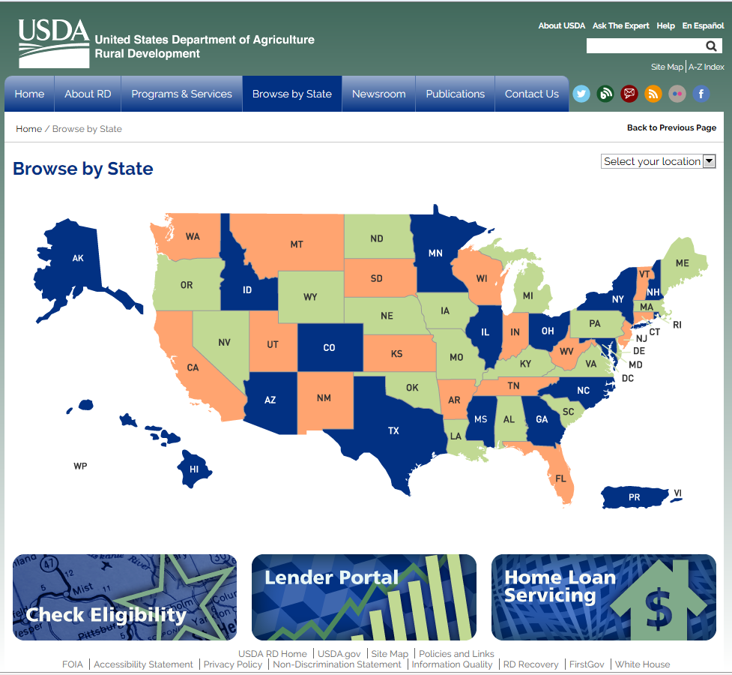
Rural Development Offices
http://www.rd.usda.gov/browse-state

Slide 7
Challenges in Rural Communities
Outmigration: More people are moving out than moving in.
Declining Labor Force: Employment losses persisted in many rural areas, including much of the South, Appalachia, Northwest, and Mountain West.
Aging Population: On average, rural populations are older than populations in other parts of the country. They face extra challenges such as transportation to medical and other essential services.
College Education: Rural areas had a far greater proportion of working-age adults with a high school diploma but no further education, and a slightly greater proportion with some college experience but less than a 4-year degree. Many young adults leave rural areas to attend college, and many of these people remain in urban areas after college due to the higher earnings available to them in those areas.
Poverty and Childhood Poverty: 85 percent of the nation’s poor are in rural and one in four rural American children live in poverty.
Notes:
Outmigration: Total population in rural areas has declined over the years. More people are moving out than moving in. Spurred by an energy boom, some rural areas have turned around decades of population decline. Regions such as eastern Texas and parts of rural Pennsylvania have gained population from energy-related job growth, but the demographic impact has been more apparent in sparsely settled regions such as western North Dakota and eastern Montana. Many communities in these areas face housing shortages, overburdened public services, traffic congestion, and other new challenges associated with rapid growth.
Declining Labor Force: The rural unemployment rate has declined in line with national trends, but these declines are due more to a decline in the labor force participation rate than to an increase in the number of people employed. Employment losses persisted in many rural areas, including much of the South, Appalachia, Northwest, and Mountain West.
Aging Population: On average, rural populations are older than populations in other parts of the country. Older adults who live in rural areas have the same concerns as other rural residents. However, they may face additional challenges such as transportation to medical services, grocery shopping, and other essential services; housing quality and affordability including paying for repairs, and availability of home and community-based services and long-term care.
College Education: Based on 2008-2012 data, the share of working-age adults with at least a 4-year college degree was 14 percentage points higher in urban areas than in rural areas (32 percent versus 18 percent). Rural areas had a far greater proportion of working-age adults with a high school diploma but no further education, and a slightly greater proportion with some college experience but less than a 4-year degree. Many young adults leave rural areas to attend college, and many of these people remain in urban areas after college due to the higher earnings available to them in those areas.
Poverty Levels: About 1 out of every 16 persons in the United States lives in deep poverty, with an income below 50 percent of the Federal poverty line. Poverty and lack of opportunity are especially acute in rural regions and can become entrenched. The South is still home to much of the Nation’s most severe poverty, but impoverishment has grown across the Midwest, Southwest, and Pacific, as well as in the Northeast, even though Northeastern rates remain relatively low. Deindustrialization contributed to the spread of poverty in the Midwest and the Northeast, while the Southeast made some economic progress, in part by attracting manufacturing jobs. Another factor was rapid growth in Hispanic populations, which tend to be poorer, particularly in California, Nevada, Arizona, Colorado, North Carolina, and Georgia.
Childhood Poverty: More than one third of rural Americans and one in four rural American children live in poverty. The highest rates of deep poverty among children are in rural areas of the Southwest and the North Central Midwest, on Native American lands, and in historically poor regions of the rural Southeast, while the lowest rates are in the Northeast. Research suggests that the more time a child spends in poverty or living in a high poverty area, particularly those with concentrations of racial and ethnic minorities, the greater the chance of being poor as an adult.

Slide 8
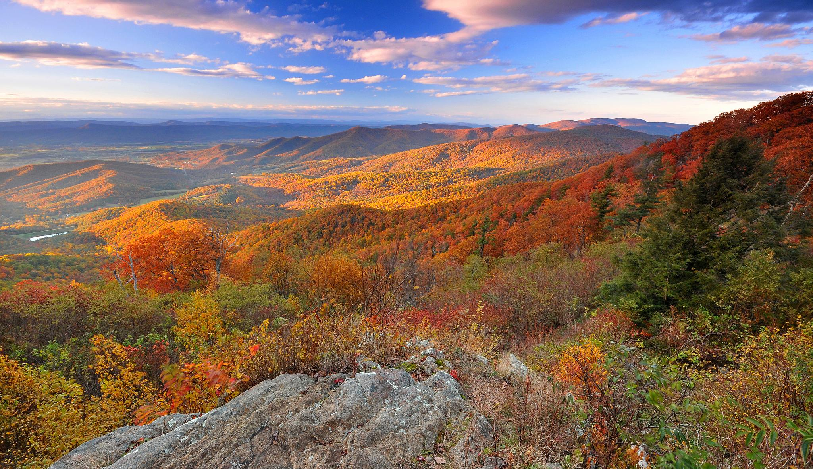
Why Recreational Economy?

Slide 9
“Today, the country looks to rural America to not only provide food and fiber, but also for crucial emerging economic opportunities in renewable energy, broadband, and recreation.”
-USDA Strategic Plan 2014-2018

Slide 10
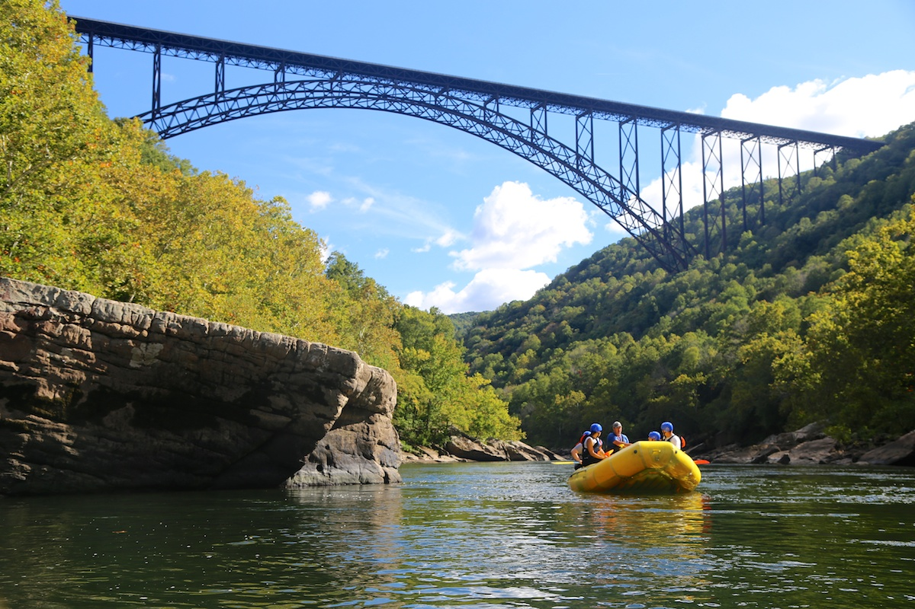
Where are our target communities are?

Slide 11
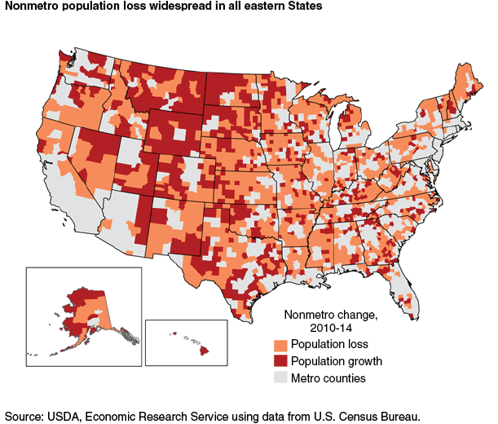
Outmigration
Population Losses
Economic Recession
Global Competition
Population Gains
Energy
Recreation
Technology
Housing
Notes:
The number of people living in nonmetropolitan (nonmetro) counties stood at 46.2 million in 2014, representing nearly 15 percent of U.S. residents spread across 72 percent of the Nation's land area. Nonmetro areas lost population between July 2013 and 2014, continuing a 4-year trend. While hundreds of individual nonmetro counties have lost population over the years, this is the first recorded period of overall population decline. The recent economic recession, increased global competition, and technological changes led to widespread job losses in rural manufacturing and have contributed to the nonmetro population decline since 2010. Also, suburban expansion and migration to scenic retirement/recreation destinations have weakened since 2010.
In the past, population loss was concentrated in the Great Plains and extended into Corn Belt areas of Midwestern States. Population loss also historically occurred in areas of relatively high poverty in the southern Coastal Plains and in Appalachia. New geographic patterns since 2010 extend population loss throughout the eastern half of the United States, especially in manufacturing-dependent regions such as along the North Carolina-Virginia border and southern Ohio. The housing mortgage crisis slowed suburban and exurban development in nonmetro counties near metro areas, considerably reducing the number of adjacent nonmetro counties experiencing population growth.
Not all nonmetro counties have lost population since 2010. Approximately 700 nonmetro counties had population increases, together adding over 400,000 residents. New growth patterns have emerged in post-recession years. Population growth continued in most areas of the Mountain West but slowed considerably for the first time in decades. Numerous recreation-dependent counties in Oregon, Idaho, Nevada, and elsewhere switched from relatively rapid growth before the housing mortgage crisis to decline during 2010-14. At the same time, large sections of the northern Great Plains started gaining population after decades of persistent population decline, due largely to in-migration of workers during the shale oil and gas production boom. Other nonmetro regions, such as southeastern New Mexico and parts of eastern Texas, also experienced population gains from energy-related job growth.
America’s Federal lands are precious national assets that are an important source of employment in rural areas through their support of the tourism industry. These lands -- wildlife refuges, national parks, national forests, and Bureau of Land Management lands -- are located disproportionately in rural areas. Recently, there have been more than 620 million annual visits to these lands, including over 310 million to national parks and wildlife refuges. The Department of the Interior estimates that its lands support over 320,000 jobs in tourism and recreation (Department of the Interior 2009). Recent studies estimate that the National Park Service alone annually contributes $6.3 billion in labor income and $9 billion in value added (Stynes 2009), the wildlife refuges provide an estimated $1.7 billion in sales and $542.8 million in employment income (Carver and Caudill 2007), and recreational visits to the National Forests contribute $11.2 billion to GDP (Department of Agriculture 2010a).
America’s Federal lands support a wide variety of activities. Every year, about 7 million anglers visit national wildlife refuges, as do 2 million hunters and many millions of birders (Carver and Caudill 2007). Of those surveyed on their national forest recreation visits, the primary activities were hiking or walking, downhill skiing, viewing natural features, hunting, and fishing. Additionally, about 40 percent listed viewing wildlife as an activity in which they participated. Recreation and tourism on Federal lands is a growth industry, with the potential to increasingly benefit rural America. For example, the Department of Agriculture estimates that the number of visitors has increased at national forests from 134 million in 1964 to 206 million in 2007 (Department of Agriculture 2008, 2010b). Likewise, the number of recreation visits to the national parks has increased from 205 million in 1979 to 275 million in 2008.
Unfortunately, two problems -- deferred maintenance and damaged ecosystems -- prevent America’s Federal lands from reaching their full economic potential. In 2009, the Fish and Wildlife Service, Bureau of Land Management, National Parks Service, and Forest Service had a combined deferred maintenance project backlog of between $16 and $22 billion. The Forest Service estimates that 37 percent of its administrative facilities need major repairs or renovations (Department of Agriculture 2009). The failure to do needed maintenance leads to eroded roads, closed-off trails, and hazardous dilapidated buildings, and reduces the safety and accessibility of America’s Federal lands. In turn, this makes them less attractive tourist destinations.
Similarly, a legacy of damaged ecosystems has decreased the attractiveness of many Federal lands. Aside from the reduction in ecosystem services that these lands provide to the whole country, the harms to recreation and tourism take many forms. Whether through decreasing bird biodiversity that attracts birders, fish abundance that attracts recreational fishermen, the population of native species prized by amateur naturalists, or the quality and quantity of water available for water recreation, ecosystem degradation is harmful to tourism on Federal lands. For example, the Forest Service estimates that 25 million acres of its lands are at future risk from insects and diseases (Department of Agriculture 2009). Furthermore, a legacy of counterproductive fire suppression has led to an excessive build-up of combustible material on Federal lands, leading to more extreme wildfires which -- aside from endangering surrounding communities -- harm ecosystems and site facilities, keeping away visitors.

Slide 12
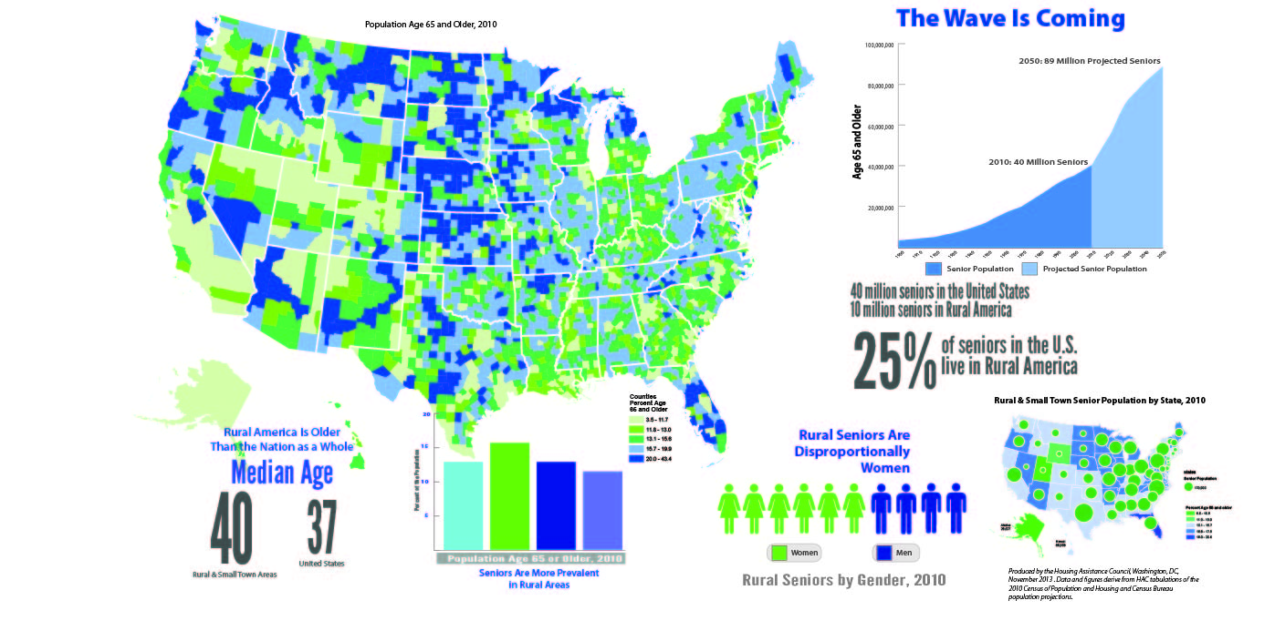
Aging Population
Notes:
Rural Oregon counties boast a sizable number of working-age households for now, but birth and death statistics show that could drastically change in the future, state economist Mark McMullen said at the Human Services Coalition of Oregon's annual meeting Wednesday.
Deaths outnumbered births in 13 of Oregon's 36 counties in 2010. All 13 of those counties were rural, with Curry, Grant and Lake counties having the lowest ratios of births to deaths, data from the Office of Economic Analysis indicated.
In Rural Communities, Elderly Populations Rely on Other Seniors to Act as Caregivers
Historically, young adults have moved away from rural communities to get jobs, for education, or to join the military. With fewer young adults remaining or returning and having children, population aging results in natural decrease, a trend that is increasing rapidly in nonmetropolitan counties.

Slide 13
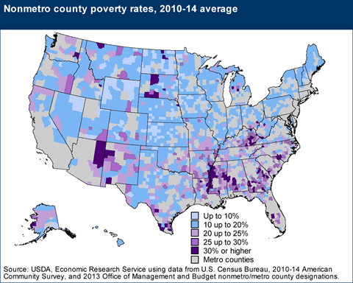
Persistent Poverty
In 2014, Rural Poverty Rate was 18.1%. Urban rate was 15.1%
High poverty are concentrated in the South mainly in MS Delta, Appalachia, and Native American lands
Poverty in rural is highest amongst African & Native Americans
Child poverty highest in rural, 25.2%
5 out of every 10 rural families headed female single parent are poor
A higher portion of rural residents are on disability
Notes:
In 2008, disability insurance enrollment as a share of the working-age population was 6.5 percent in high-density rural areas and 5.7 percent in low-density rural areas, compared with 3.9 percent in urban areas.¹⁰ Thus, the average rural resident was much more likely to be enrolled in SSDI than his or her urban counterpart. Because individuals enrolled in SSDI are unlikely to exit from the program, these disparities are also likely to impact future labor force capacity.¹¹

Slide 14
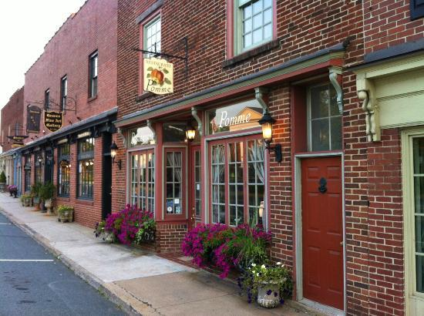
What’s Available for Technical Assistance and Financing?

Slide 15

Rural Business & Cooperative Service (RBCS)
Business Programs
Intermediary Relending Program
Rural Business Development Grants
Rural Business Investment Program
Rural Economic Development Loan & Grant Program
Rural Microentrepreneur Assistance Program
Business & Industry Loan Guarantees
Energy Programs
Rural Energy for America Program (REAP)
Advanced Biofuel Payment Program
Repowering Assistance Program
Rural Energy for America Program (REAP) Energy Audits & Renewable Energy Development Grants
Biorefinery, Renewable Chemical, and Biobased Product Manufacturing Assistance Program
Cooperative Programs
Socially-Disadvantaged Groups Grants
Rural Cooperative Development Grants
Delta Health Care Services Grants
Value Added Producer Grants
Cooperative Training and Technical Assistance
Stronger Economies Together Initiative
Strategic Economic and Community Development (Farm Bill 6025)
Promise Zones
Strikeforce

Slide 16


Rural Housing Service (RHS)
Multi-Family Housing
Farm Labor Direct Loans & Grants
Housing Preservation & Revitalization Demonstration Loans & Grants
Housing Preservation Grants
Multi-Family Housing Direct Loans
Multi-Family Housing Loan Guarantees
Multi-Family Housing Rental Assistance
Single-Family Housing
Mutual Self-Help Housing Technical Assistance Grants
Single Family Housing Direct Home Loans
Single Family Housing Home Loan Guarantees
Single Family Housing Repair Loans & Grants
Community Facilities
Community Facilities Direct Loans & Grants
Community Facilities Loan Guarantees
Economic Impact Initiative Grants
Rural Community Development Initiative Grants
Tribal College Initiative Grants

Slide 17
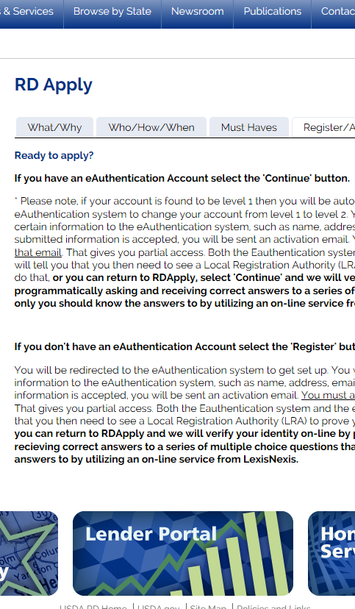
Rural Utility Service (RUS)
Electric Programs
Denali Commission High Energy Cost Grants
Distributed Generation Energy Project Financing
Electric Infrastructure Loan & Loan Guarantee Program
Energy Efficiency & Conservation Loans
High Energy Cost Grants
State Bulk Fuel Revolving Loan Fund
Telecommunications Programs
Community Connect Grants
Distance Learning & Telemedicine Grants
Farm Bill Broadband Loans & Loan Guarantees
Telecommunications Infrastructure Loans & Guarantees

Slide 18

Rural Utility Service (RUS)
Water & Environmental Programs
Circuit Rider Program
Emergency Community Water Assistance Grants
Grants for Rural and Native Alaskan Villages
Household Water Well System Grants
Individual Water & Wastewater Grants
SEARCH - Special Evaluation Assistance for Rural Communities and Households
Solid Waste Management Grants
Water & Waste Disposal Grants to Alleviate Health Risks on Tribal Lands and Colonias
Water & Waste Disposal Loans & Grants
Water & Waste Disposal Loan Guarantees
Water & Waste Disposal Predevelopment Planning Grants
Water & Waste Disposal Revolving Loan Funds
Water & Waste Disposal Technical Assistance & Training Grants

Slide 19
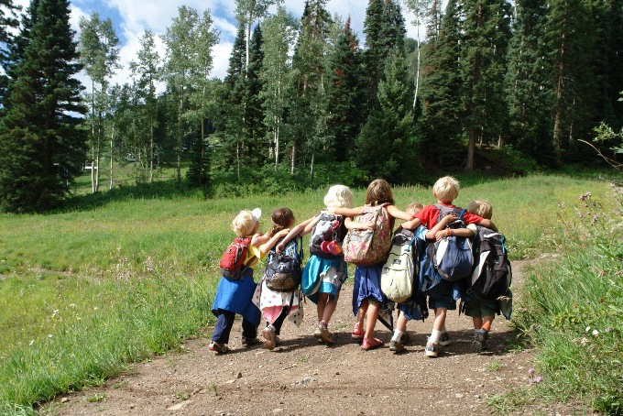
How to Get it Done?
Examples of projects funded by Rural Development
Cooperative Development as a Business Model

Slide 20
Farm Bill 6025 Strategic Economic & Community Development
Over $300 million program set asides to prioritize projects that help implement multi-jurisdictional plans:
  Rural Business Development Grant Program (RBDG)
  Business & Industry Guaranteed Loans (B&I)
  Community Facilities Loan and Grant Programs (CF)
  Water and Environmental Loan and Grant Programs (WEP)
Deadline: June 30, 2016
For more information: http://www.rd.usda.gov/programs-services/strategic-economic-and-community-development

Slide 21
Examples
Oregon
  Columbia River Inter-Tribal Fish Commission received about $400K of multiple grant awards from RBDG for marketing and working capital for salmon business
Colorado
  Powderhorn Resort used $5 million B&I Loan for high speed lift which also detaches to allow for Mountain Bikes which expands their opportunity to year round.
  Durango/Silverton RR, Strater Hotel and Purgatory Ski Resort, all different projects and purchasers, with B&I Loan.
North Carolina
  Nantahala Outdoor Center, LLC used $7 million B&I Loan to refinance debt and fund new capital for outdoor guide service and establish retail store to create/maintain jobs for 822 people
  Seamist Camping Resort used $5 million B&I Loan to refinance existing debt on the RV campground that has been in existence for 30 years.

Slide 22
Examples
Virginia
  Evergreen Sports Complex, a large soccer / lacrosse facility just outside of Leesburg, VA acquired a B&I Loan for a marina, campground, restaurant and hotel complex on Smith Mountain Lake (Halesford Harbor).
Kentucky
  South Kentucky Rural Electric Cooperative Corporation used REDLG to fund and build marinas
West Virginia
  Ashland Scenic Campground - $1.0 Million B&I loan guarantee to expand a full-service RV Park and Lodge Resort located in Mcdowell County, WV. ATV enthusiasts travel to this destination resort park to take advantage of the Hatfield McCoy Trail. Natural tourism is a bright spot for Mcdowell County. Reeling from its turn-of-the-century economic high in coal mining, Mcdowell County is the poorest county in West Virginia and has been labeled as a Strikeforce County.

Slide 23
Examples
Vermont – New Hampshire
  Northern Forest Canoe Trail utilized RBDG to link the waterways of Vermont’s Northeast Kingdom REAP Zone, New York, Vermont, Quebec, New Hampshire and Maine to provide nature-based tourists access to scenic waterways and the small business services available in the rural communities along the trail. Multiple planning and technical assistance grants have supported the sustainability of rural small businesses along the trail system. Systematically, the projects have created a seamless tie between nature enthusiasts using the trail system and the small businesses and communities along the trail. Development of a “Trip Planner” and marketing materials are examples of how funds have been deployed to tie rural small business development to regional tourism network.
  Northern Community Investment Corporation used RBDG to fund a network of “wireless internet repeaters” to benefit small and emerging businesses not otherwise served by conventional high-speed internet service. Notably, a USDA funded B&I Loan Guarantee – Tree Corners Family Campground – in rural Irasburg, Vermont was able to take advantage of the repeater service thereby supporting business functions including website, reservations, communications and internet service for guests. The project serves Vermont’s Northeast Kingdom REAP Zone.

Slide 24
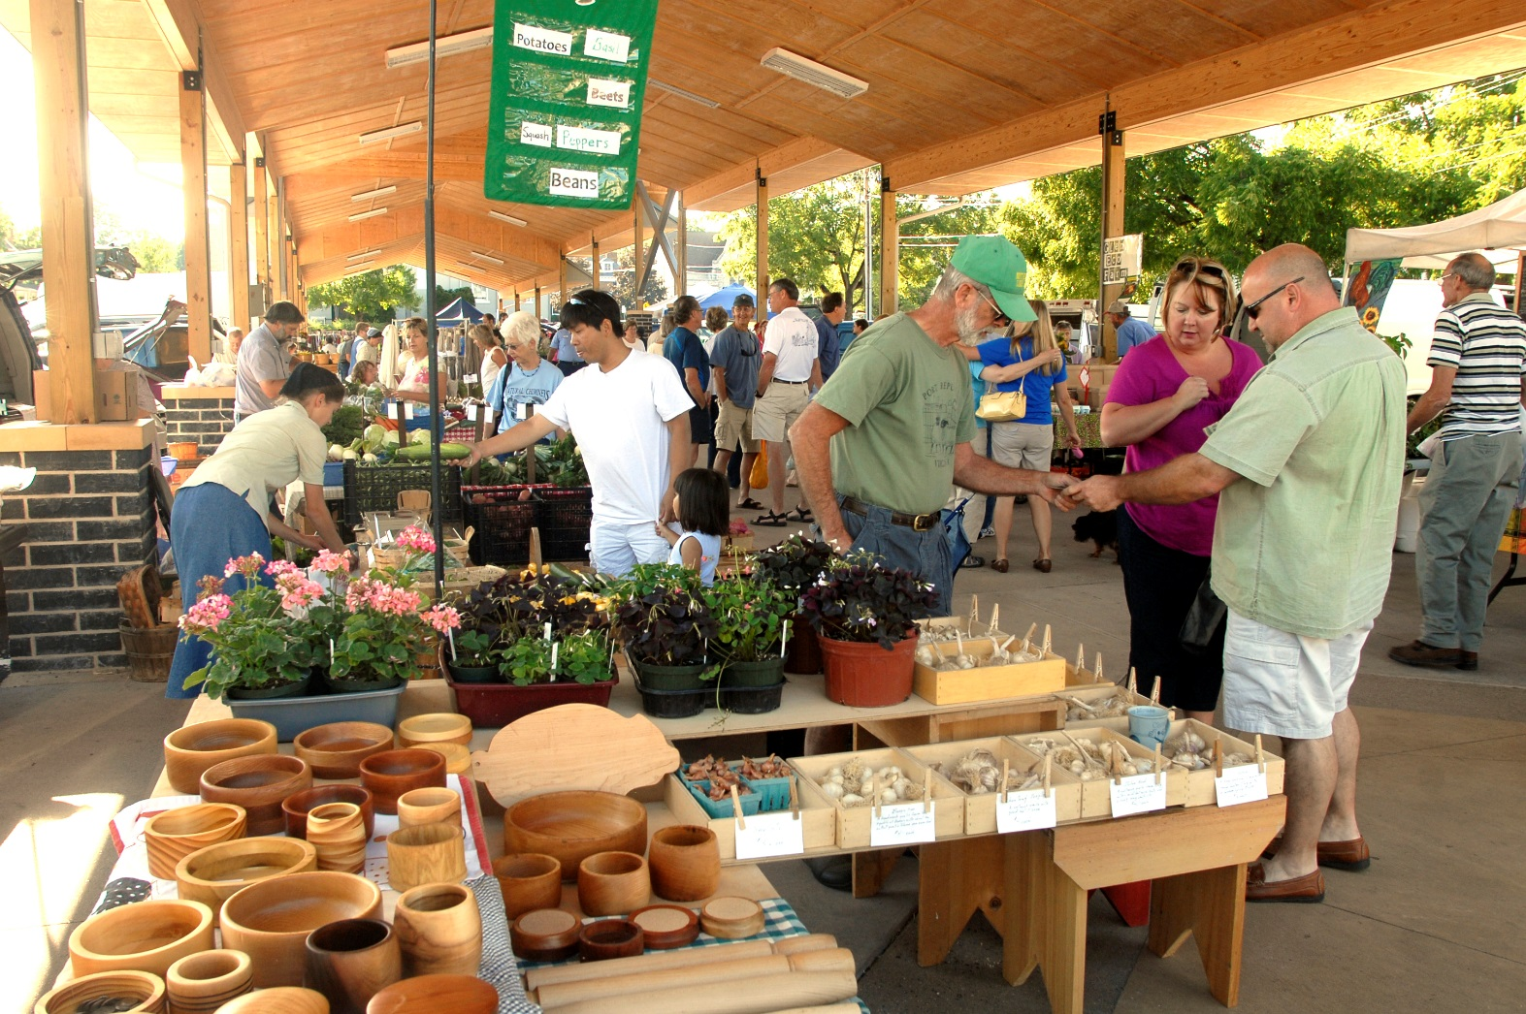
Cooperative Development
Shared Capital
Shared Ownership
Shared Management
Shared Benefits

Slide 25
Examples
Sporting Goods:
  REI is one of the nation’s largest sporting goods chains, geared heavily toward outdoor sports. https://www.rei.com/about-rei/business.html
  Mountain Equipment Cooperative: http://www.mec.ca/AST/ContentPrimary/AboutMEC/AboutOurCoOp.jsp
Biker Cooperatives:
  http://www.citybikes.coop/ (in Portland, OR)
  http://velocitycoop.org/ (in Alexandria, VA)
  http://www.ccaglobalpartners.com/divisions/the-bike-cooperative
Forest Land Owner Cooperatives:
  http://www.partnersinforestry.com/ http://www.uwcc.wisc.edu/pdf/Bulletins/bulletin_03_04.pdf

Slide 26
Examples
Public Transportation: Linx Transportation Cooperative for Yellowstone Park: http://www.nic.coop/focus-articles/linx.aspx
Ski Resort Cooperative: http://www.madriverglen.com/coop/about-the-coop
Wine Tasting Cooperative: http://www.familywineriesdrycreek.com/what-we-do/
Wine Trail Cooperative:
  http://www.wisconsinwineryco-op.com/index.asp
  http://www.ptshipwrights.com/wp/about/
Hunting Cooperative: https://tpwd.texas.gov/business/licenses/media/PWD%20850%20Hunting%20Lease%20Info.pdf
Sailing Cooperative: http://www.cal-sailing.org/
Camp and Festival Ground: https://mesaba.wordpress.com/
Retirement Communities by the Lake:
  http://www.bestguide-retirementcommunities.com/manufacturedhomesinflorida.html
  http://cortezparkflorida.com/

Slide 27
Any questions?
Claudette Fernandez
Rural Business-Cooperative Service
USDA Rural Development
Claudette.Fernandez@wdc.usda.gov
Phone: 202-365-5320

Slide 28

The U.S. Department of Agriculture (USDA) prohibits discrimination in all its programs and activities on the basis of race, color, national origin, age, disability, and where applicable, sex, marital status, familial status, parental status, religion, sexual orientation, genetic information, political beliefs, reprisal, or because all or part of an individual's income is derived from any public assistance program. (Not all prohibited bases apply to all programs.) Persons with disabilities who require alternative means for communication of program information (Braille, large print, audiotape, etc.) should contact USDA's TARGET Center at (202) 720-2600 (voice and TDD). To file a complaint of discrimination, write to USDA, Director, Office of Civil Rights, 1400 Independence Avenue, S.W. , Washington , D.C. 20250-9410 , or call (800) 795-3272 (voice) or (202) 720-6382 (TDD). USDA is an equal opportunity provider and employer.

