Slide 1
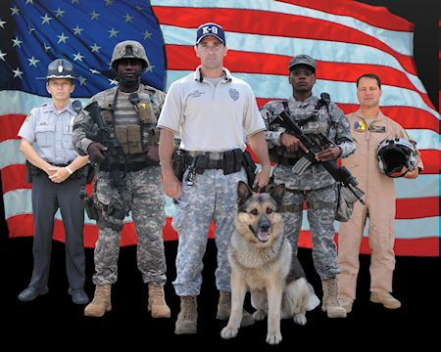
Mission First…People Always!
Small Business Opportunities
November 9, 2017

Slide 2
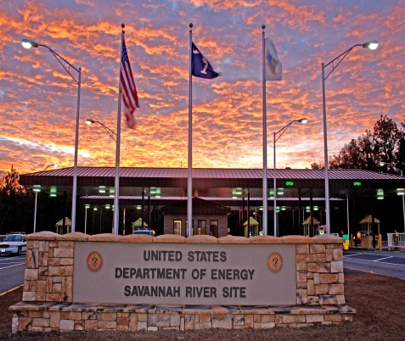
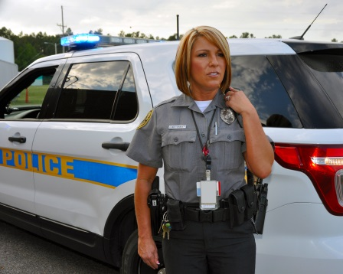
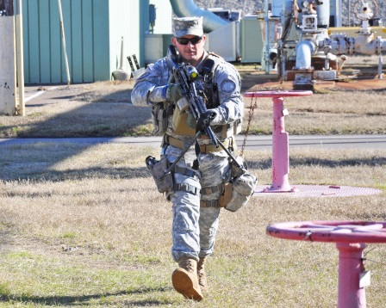
A paramilitary organization providing total security services at SRS, including access control, property protection, law enforcement, aviation support, alarm assessment and tactical response
Providing the expertise to protect nuclear materials, the environment, SRS employees and the surrounding communities since 1983
Mission is to ensure site operations are not disrupted by criminal or terrorist acts, while protecting site employees, sensitive information and materials
Notes:
Who are we and what do we do?

Slide 3
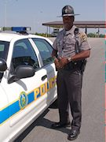
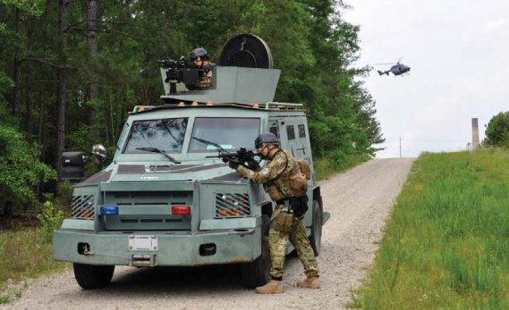
Law Enforcement Department accredited by Commission on Accreditation for Law Enforcement Agencies
Police canine teams certified by the United States Police Canine Association
Aviation Operations Department, recognized by GSA and DOE for excellence in safety, maintenance and operations, and certified by the Federal Aviation Administration
Special Response Team, highly trained and equipped to execute rapid and integrated response to terrorist activities
Notes:
Our workforce consists of:

Slide 4
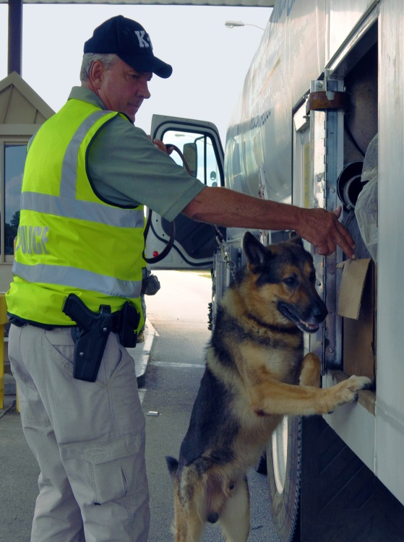
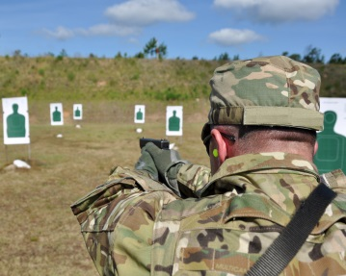
Protective Force personnel who control site access, perform inspections, respond to alarms
Certified instructors providing scenario-based team and leadership training for our Protective Force
Administrative staff comprised of professionals in performance testing, total quality, safety, human resources, compensation and benefits, logistics, IT, finance and contracts, and labor relations
Notes:
Workforce cont. – “Our workforce also includes:”

Slide 5
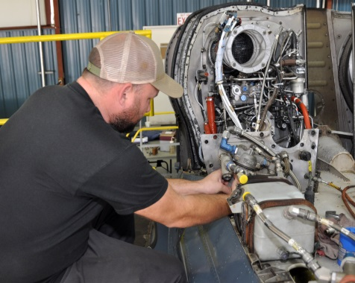
Approximately $8M spent annually on goods and services
Majority of purchases are for goods: tactical gear, ammunition, uniform/athletic clothing and footwear, computer hardware/software, office supplies, automotive and aircraft parts and supplies
Services include equipment calibration and repairs, laundering services, shredding services, pre-employment services (background investigations, physicals), air/soil testing
Notes:
Overview of purchasing activities

Slide 6
Opportunities for FY18
Acquisition Description
IT Supplies and Equipment
Office Supplies and Equipment
Tactical Gear and Accessories
Weapon Parts and Cleaning Supplies
Software Maintenance Renewals
Equipment Calibration and Repairs
Locksmith Supplies
Safety Supplies
Ammunition
Notes:
Upcoming Opportunities – “this is just a general idea of what we will be ordering during FY 18; we don’t specifically plan procurement actions; they are ordered as needed”

Slide 7
Centerra-SRS utilizes various resources to locate potential suppliers: SAM, SBA’s Dynamic Small Business Search, GSA, other site contractor recommendations
Suppliers must be registered in SAM
Over1500 suppliers in our database, 1300+ are small businesses
FY16 – close to $550K in commitments to small businesses in GA and SC
Suppliers may reach out to our procurement staff via phone or email
Notes:
Supplier Information – “In regards to our suppliers”:

Slide 8
Contact Information
Liz Harris
Procurement Administrator and Small Business Program Manager
Phone: (803) 952-7630
Email: liz.harris@srs.gov
Antoinette Kelly
Procurement Specialist
Phone: (803) 952-8532
Email: antoinette.kelly@srs.gov
Corilla Maile
Manager, Finance and Contracts
Phone: (803) 952-8897
Email: corilla.maile@srs.gov
Notes:
Contact Information

