Slide 1
South Carolina Lowcountry Promise Zone Connected Community
Jim Stritzinger
Executive Director, Connect South Carolina

Slide 2
Context
Access
The physical connection to high-speed infrastructure
Adoption
Recognizing the value of broadband and subscribing either at home, work, or via public institutions
Use
Skills and applications to leverage technology to improve quality of life and community/economic development
Connected Nation and state subsidiary, Connect South Carolina, are non-profit organizations dedicated to expanding broadband access, adoption, and use
Core competencies include:
Network mapping, validation, and analysis
Residential and business adoption research
Local, state, and national policy analysis
Digital Inclusion programming and training
Capacity building and technical assistance
Community technology planning
Connected Community Engagement Program (Connected)
Supply
Demand

Slide 3
Connected
Field-validated technology planning program to facilitate the expansion of broadband access, adoption, and use in a community
Process overview:
Establish a local team/ task force
Assess the technology landscape
Develop a plan
Implement projects to expand broadband access, adoption, and use
Empowering local, collaborative, and data-driven technology planning to inform intelligent, digital development

Slide 4
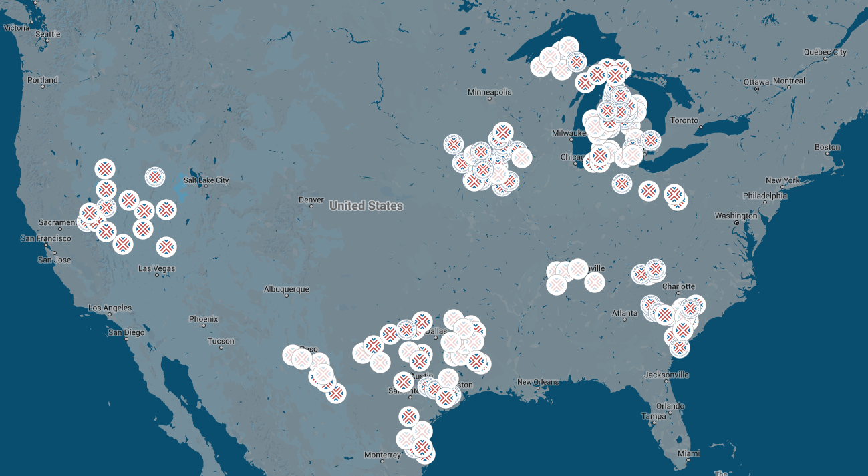
Connected
163
Communities engaged across Florida, Iowa, Michigan, Ohio, Tennessee, Nevada, Pennsylvania, South Carolina, and Texas.
Local technology action plans delivered
143
Connected communities are part of a growing body of
technology-for-community-development best practice in nine states

Slide 5
Promise Zone Connected Team
Establish a knowledgeable team of local experts to guide data collection and plan development and implementation
Those assisting with this project include:
EdVenture Children’s Museum
Allendale County School District
Bamberg School District One
Barnwell School District 45
Blackville-Hilda Public Schools
Colleton County School District
Denmark Olar School District 2
Hampton County School District 1
Hampton County School District 2
Jasper County School District
Williston-Elko School District
Denmark Technical College
LeaderComm
University of South Carolina
Counties of Allendale, Bamberg, Barnwell, Colleton, Hampton, and Jasper
Lower Savannah Council of Governments
South Carolina Arts Commission
South Carolina Community Loan Fund
South Carolina Department of Health and Environmental Control
South Carolina Department of Commerce
South Carolina Regional Housing Authority #3
Corporation for National and Community Service
Federal Communications Commission
U.S. Economic Development Agency
U.S. Department of Housing and Urban Development
Savannah River National Laboratory
U.S. Small Business Administration

Slide 6
Promise Zone Connected Assessment
Access - infrastructure
Speed availability
Adoption – who has it
Affordability
Mobile broadband
Provider competition
Home connectivity
Digital literacy
Use – is technology being leveraged
Teleworking
Digital interaction
Devices in the home
Examine local technology landscape
Distributed community surveys to gather data on local broadband and technology access, adoption, and use that is otherwise unavailable
Utilizes public and private data to map broadband availability and identify opportunities
Provides benchmarking and a place to start to improve the technology ecosystem in the region
Notes:
A good planning program starts by establishing a baseline using available data. However, data on technology access, adoption, and use is difficult to come by.

Slide 7
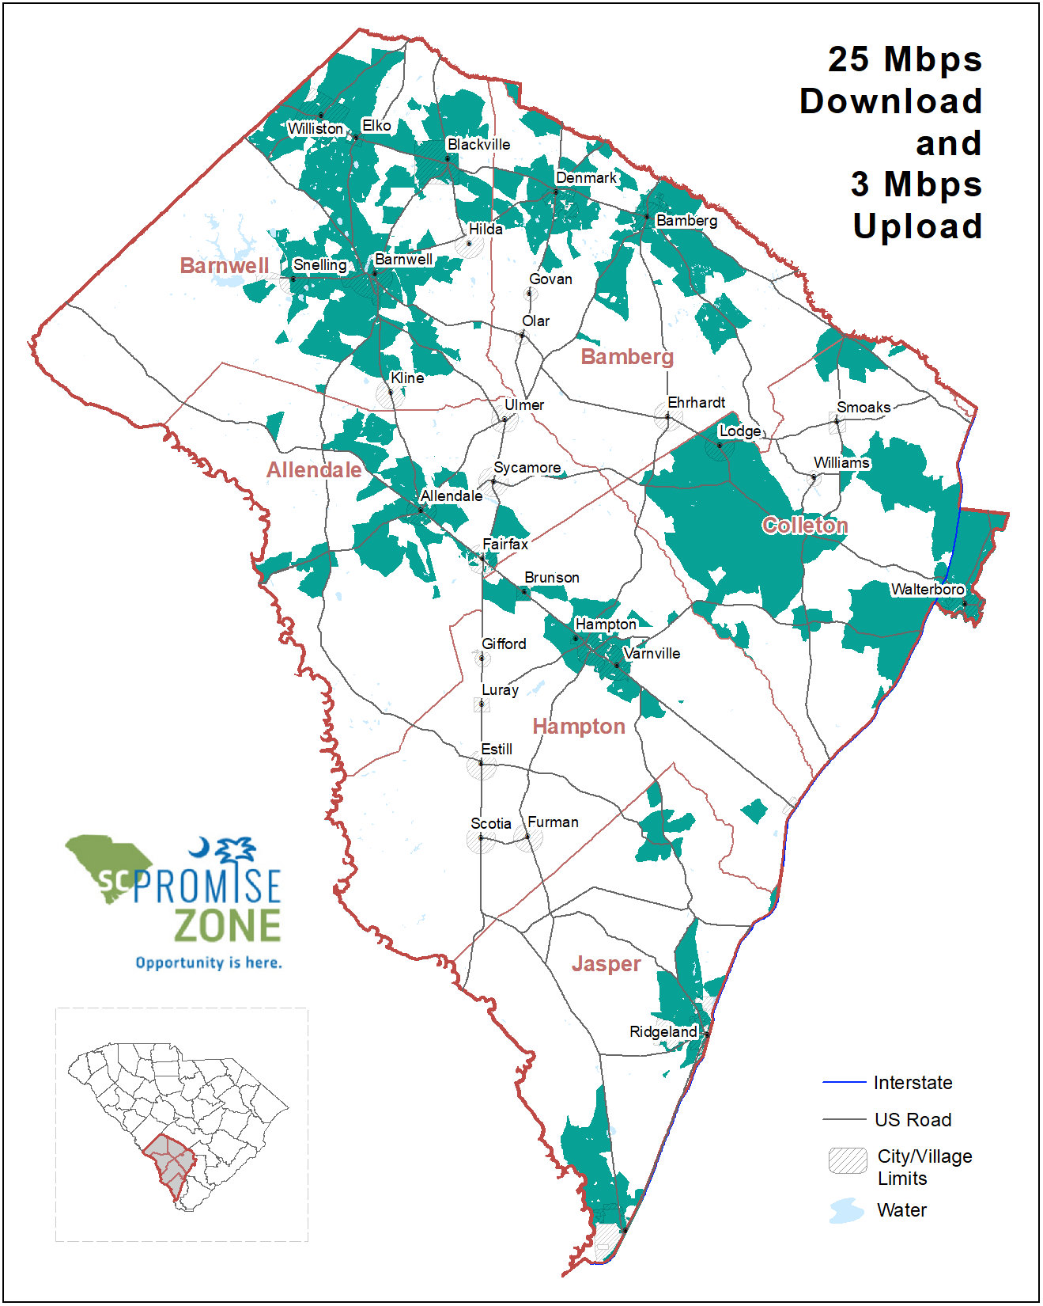
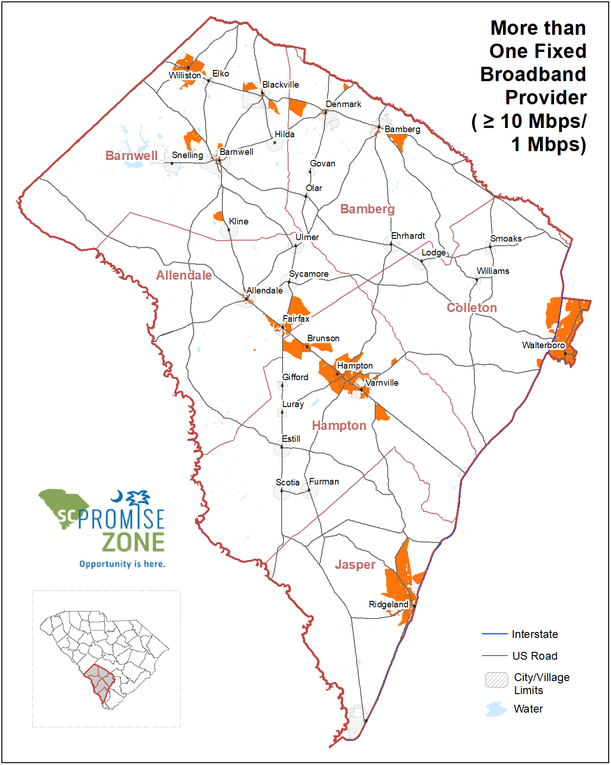
Promise Zone Assessment: Infrastructure Access
61%
Households with access to 25/3 Mbps internet
Speed
Competition
Allendale, Bamberg, Hampton, & Jasper Counties
Areas of the region where service gaps persist
63%
Residents dissatisfied with their Internet service
27%
Households with access to two or more ISPs
29Mbps
Average download speed
10
Residential fixed technology providers
89%
Land area covered by mobile broadband from at least two providers
92%
Residents interested in additional choices for internet service
Notes:
A good planning program starts by establishing a baseline using available data. However, data on technology access, adoption, and use is difficult to come by.

Slide 8
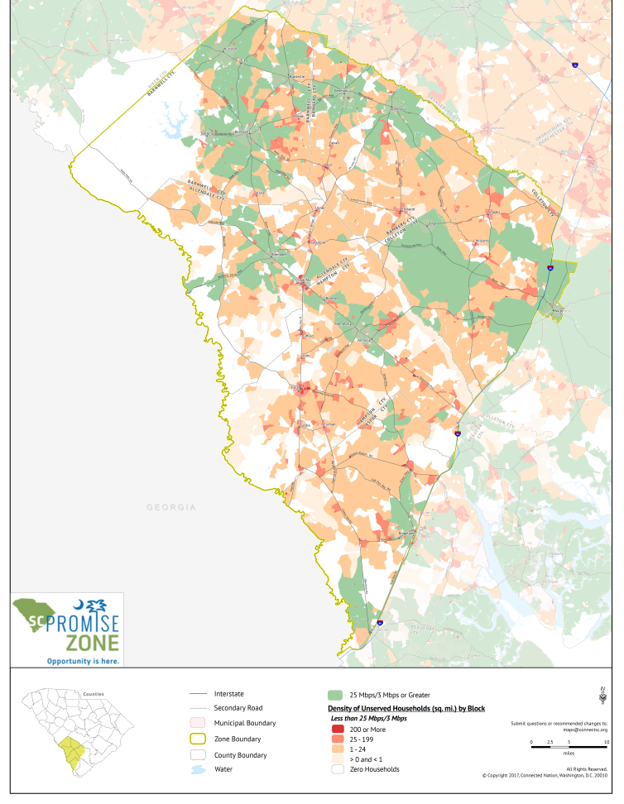
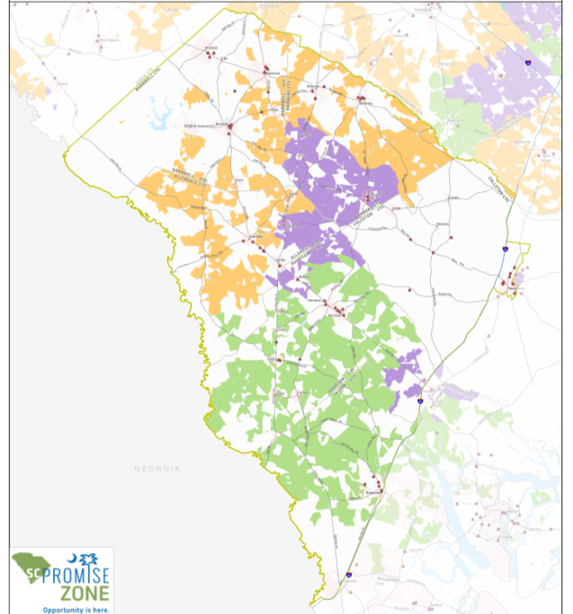
Promise Zone Assessment: Infrastructure Opportunities
Connect America Fund Eligibility:
Areas highlighted are locations eligible for build-out by AT&T, CenturyLink, and Frontier through the FCC’s Connect America Fund.
Areas of Need Analysis:
Identifies the household density for areas without access to broadband at 25/3 Mbps to more rapidly target opportunities for expansion.
Notes:
A good planning program starts by establishing a baseline using available data. However, data on technology access, adoption, and use is difficult to come by.

Slide 9
Promise Zone Assessment: Adoption
28,474
Households without a fixed home internet connection
46%
Disconnected households citing cost as the barrier to internet service
2.6% vs. 1.5%
Avg. amount of household income spent on internet service in the Promise Zone vs. the rest of South Carolina
$69.00
Average monthly cost of Internet service
37%
Residents stating they need to learn about cyber-safety
24%
Residents stating they need to learn how to conduct an online job search
Notes:
A good planning program starts by establishing a baseline using available data. However, data on technology access, adoption, and use is difficult to come by.

Slide 10
Promise Zone Assessment: Use
4.9
Average number of internet-enabled devices in the home
22%
Residents teleworking with some frequency
70%
Residents digitally interacting with local businesses at least weekly
48%
Residents digitally interacting with the healthcare industry at least weekly
Notes:
A good planning program starts by establishing a baseline using available data. However, data on technology access, adoption, and use is difficult to come by.

Slide 11
Promise Zone Assessment: Digital Equity
The data gathered during the Connected assessment allows an analysis of digital equity in the community. Digital equity is a condition in which all individuals and communities have the information technology capacity needed for full participation in our society, democracy, and economy. Digital equity is necessary for civic and cultural participation, employment, lifelong learning, and access to essential services.
Examine ten factors to identify which groups may be struggling the most with being digitally included in their community:
Through this analysis the following groups have been identified as struggling the most with technology access, adoption, and use in the Promise Zone:
Dial-up, satellite or mobile dependency
Speed less than 3 Mbps
Dissatisfied with cost
Home broadband adoption
Monthly cost of service
Devices in the home
Digital literacy
Using the internet daily
Rate of telework
Interaction with community sectors
Households with income less than $50,000
Adults without a college degree
Adults age 55 and older
Households without school-age children
Unemployed adults
Households with active or retired military personnel
(Groups are not mutually exclusive)
Notes:
A good planning program starts by establishing a baseline using available data. However, data on technology access, adoption, and use is difficult to come by.

Slide 12
Promise Zone Plan Recommendations
Team analyzed data and identified projects and programs for the community to implement to improve access, adoption, and use
Recommendation | Priority
Complete a Vertical Assets Inventory | X
Promote Low-Cost Broadband Programs | X
Establish Homework Hotspots | X
Expand Regional Telehealth Initiatives | X
Perform an Analysis of Local Policies and Ordinances
Develop Public-Private Partnerships to Deploy Broadband Service
Create a Telework Support and Attraction Program
Facilitate a Community Technology Summit
Validate Demand for Broadband Service in Underserved Areas
Implement Cybersecurity Training
Develop a Technology Mentorship Program
Procure a Multipurpose Mobile Technology Center/Makerspace
Host Website and Social Media Classes for Local Businesses
Establish a Community Technology Academy

Slide 14
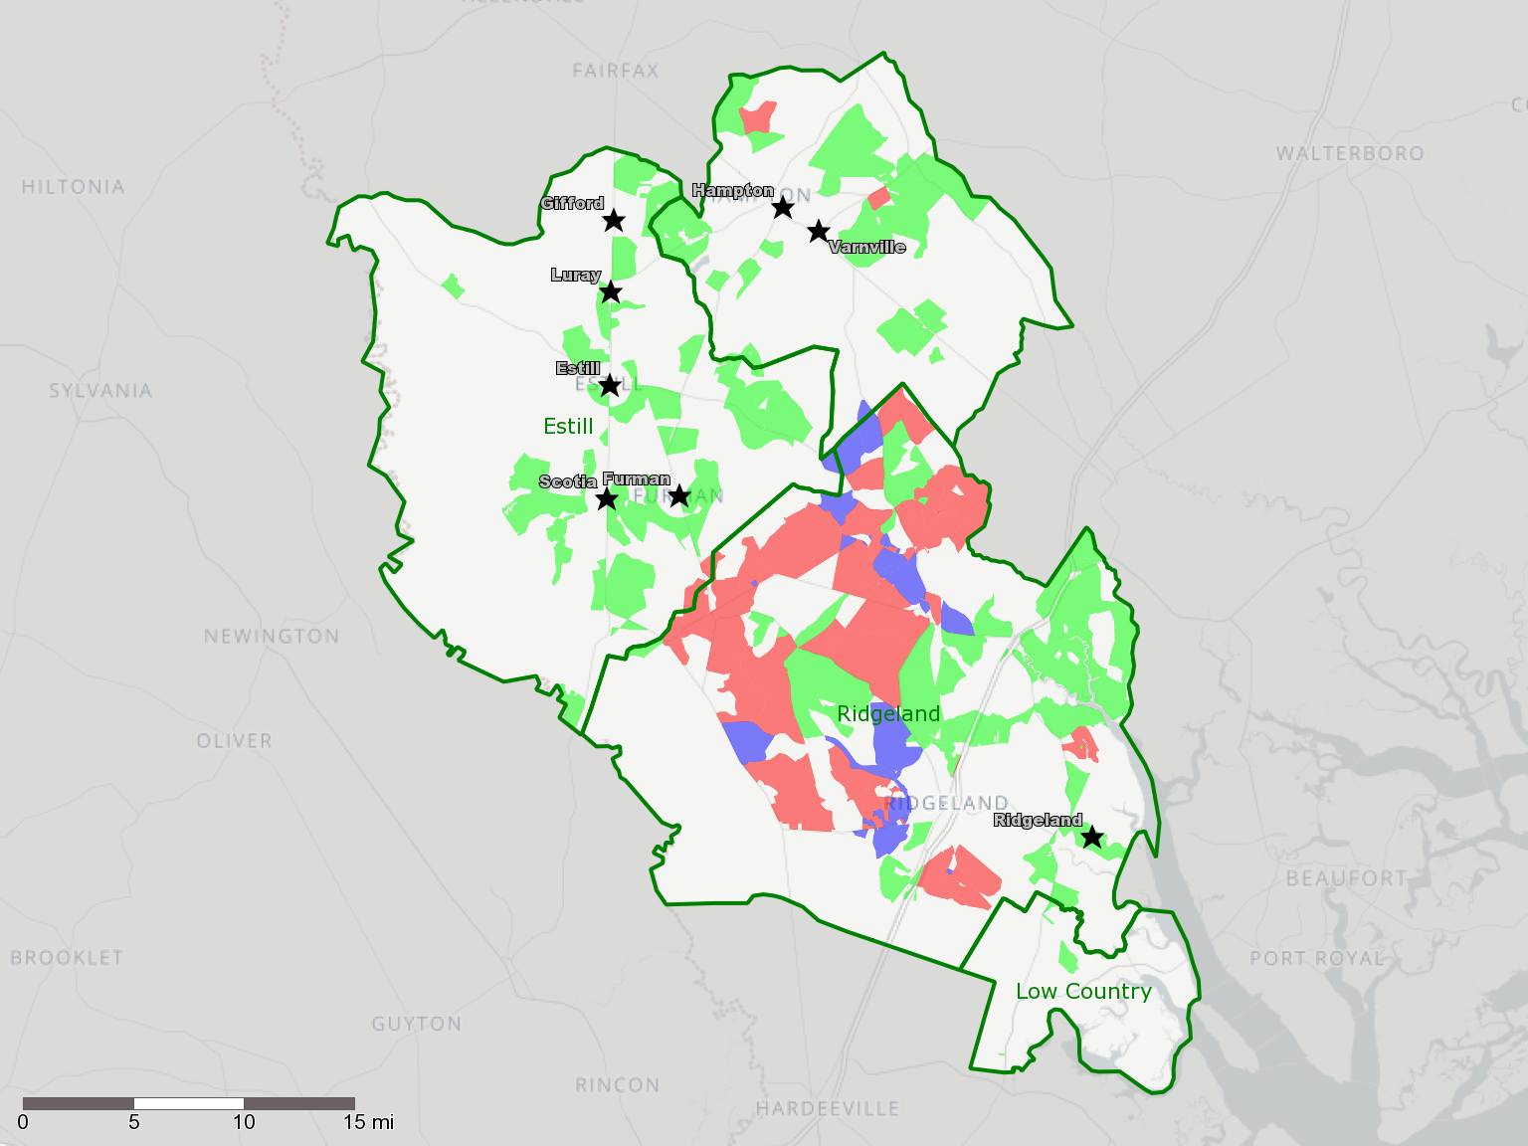
CenturyLink CAF II – Promise Zone
November 16, 2017
City
CenturyLink Exchange
CAF Enabled Area
CAF Planning Area
Potential Halo Area
CAF Enabled Areas are census blocks containing at least 1 location that qualifies for 10/1 as of June 2017. Enablement is considered preliminary until reported. Not all locations in the census block may qualify for broadband or the 10/1 speed. The CAF 2 plan represents eligible areas which CenturyLink had selected for a more detailed planning and engineering analysis to determine deployment feasibility. The identification of an area as part of the CAF 2 plan does not indicate a commitment to deploy high speed internet to the area. Halo areas represent ancillary areas that could see some benefit should HSI be deployed to near by CAF 2 eligible areas. Portions of the map data are ©2006-2017 TomTom and portions of the map data are ©2017 CenturyLink.

